Slide 1

Free online Learning Under the guidance of Prof .S.C.Sethi
STUDENT NAME
Ms.Vaishnavi Shinde, Mr. Sarthak Thorat ,Mr. Tejas Waghamare , Ms. Nikita Yadav

Slide 2

CONTENT
INTRODUCTION
OBJECTIVE
PROBLEM STATMENT
STACK USES
METHODOLOGY
UML DIAGRAM
FUTURE SCOPE & VALUE ADDITION
CONCLUSION
REFERENCE

Slide 3
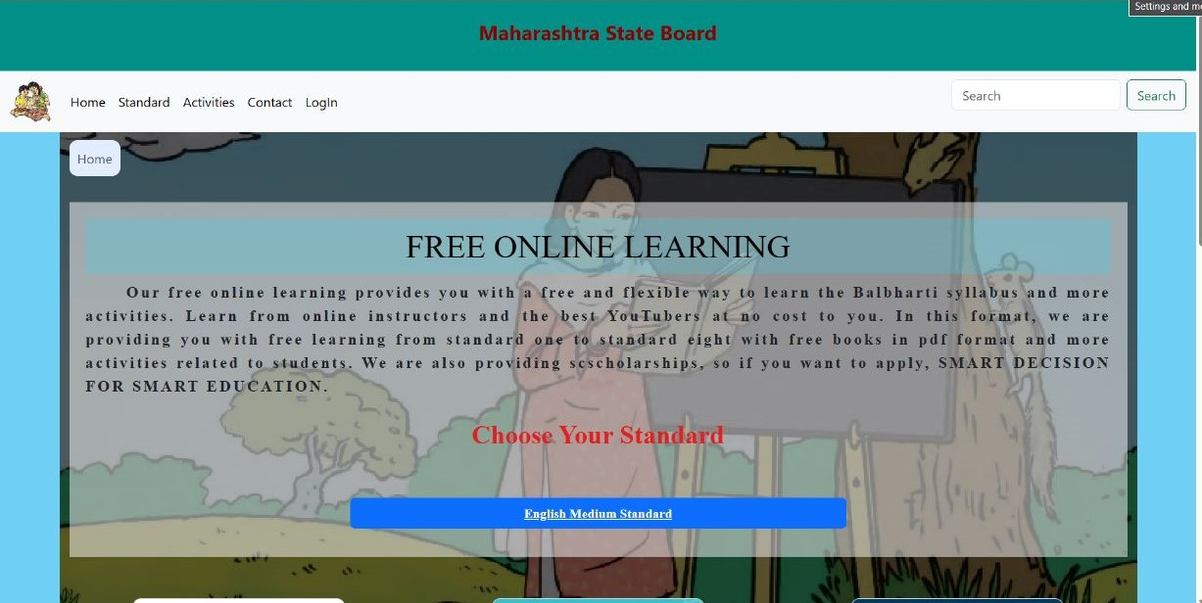
HOME PAGE

Slide 4
INTRODUCTION
Our free online learning provides for students a free and flexible way.
To learn the Balbharti syllabus as a textbook and more activities.
From traditional disciplines to emerging fields, our platform is designed to cater to the diverse interests and aspirations of learners from all walks of life.

Slide 5
OBJECTIVE
Main purpose of the project is to learn and understand the following :
Deliver Engaging Content:
Develop and acurate high-quality and interactive learning content, such as videos, textbooks, activities, and scholarships to enhance student engagement and knowledge retention.
Personalize Learning Experience:
Implement features that allow students to customize their learning path, track their progress, and receive personalized recommendations based on their interests, learning style, and performance

Slide 6
PROBLEM STATEMENT
There are so many students we see physically not attend school or those who have any problem to attend school then those student can get help from this website Online Learning. So they will not miss there syllabus.

Slide 7


Stack uses
HTML
CSS

Slide 8
METHODOLOGY
Data Collection :
In this platform we are enables the video lectures, textbooks in pdf format, so students don’t have to go anywhere and they can easily get data as they want.
Content Creation and Deployment :
we are created many pages standard wise and subject wise so students can got easily syllabus and videos.

Slide 9
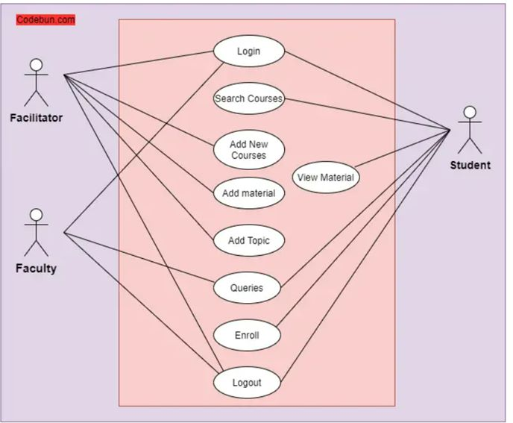
UML Diagram

Slide 10
Future scope & value addition
Mobile learning: Optimize the website and develop mobile applications to cater to the increasing number of learners accessing educational content through smartphones and tablets.
Data-driven insights: Utilize data analytics to gather insights on learner behavior, preferences, and performance.
While developers are not directly connected to IoT, they implement it in web apps.
It's important to note that while offering free education is admirable, sustainable revenue models need to be explored to ensure the long-term viability of the platform.

Slide 11
Conclusion
Developing an Online Learning website offers numerous benefits and opportunities for Students.
By creating a user-friendly platform that provides easy access to educational resources, interactive content, and personalized learning experiences, the Online Learning website can significantly enhance the learning process.
In conclusion, the development and implementation of a free online learning website provide numerous benefits and opportunities for learners worldwide.

Slide 12
REFERENCES
LINKS :
1. W3 schools https://www.w3schools.com/
2. Bootstrap https://getbootstrap.com/
3. MSB https://www.mahahsscboard.in/
4. YouTube https://www.youtube.com/

Slide 13


